Slide 1
SPACE COMPLEXITY
By,
G.Pramila

Slide 2
DEFINITION
Space Complexity = Auxiliary Space + Input space
Space complexity is the amount of memory used by the algorithm (including the input values to the algorithm) to execute and produce the result.
Auxiliary Space is the extra space or the temporary space used by the algorithm during it's execution.

Slide 3
Space complexity is often expressed asymptotically in big O notation,
O(n), O(n log n), etc.,
n - characteristic of the input influencing space complexity.

Slide 4
SPACE COMPLEXITY
Any algorithm memory may be used for the following:
Variables (This include the constant values, temporary values)
Program Instruction
Execution

Slide 5
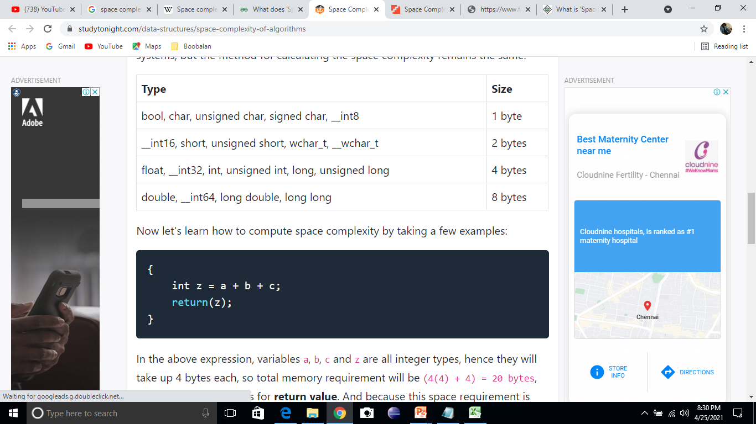
SPACE- DATA TYPES

Slide 6
CONSTANT SPACE COMPLEXITY
#include<stdio.h>
int main()
{
int a = 5, b = 5, c;
c = a + b;
printf("%d", c);
}
a, b, c and z - integer Data Type

Slide 7
4 * 3 = 12 bytes
space complexity for the above-given program is O(1), or constant.

Slide 8
Linear Space Complexity
// n is the length of array a[]
int sum(int a[], int n)
{
int x = 0; // 4 bytes for x
for(int i = 0; i < n; i++) // 4 bytes for i
{
x = x + a[i];
}
return(x);
}

Slide 9
4*n for the array a[]
x, n, i - 4 bytes for each
Space Complexity (4n + 12)
The space complexity is O(n) or linear.

Slide 10
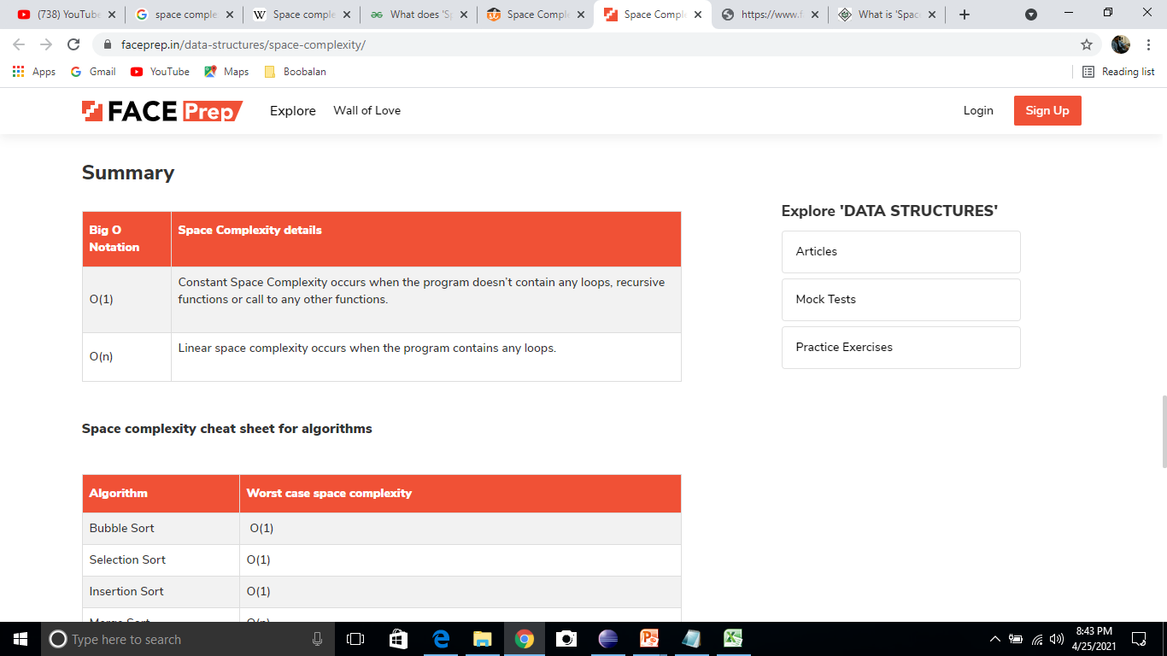
Big O Notation

Slide 11
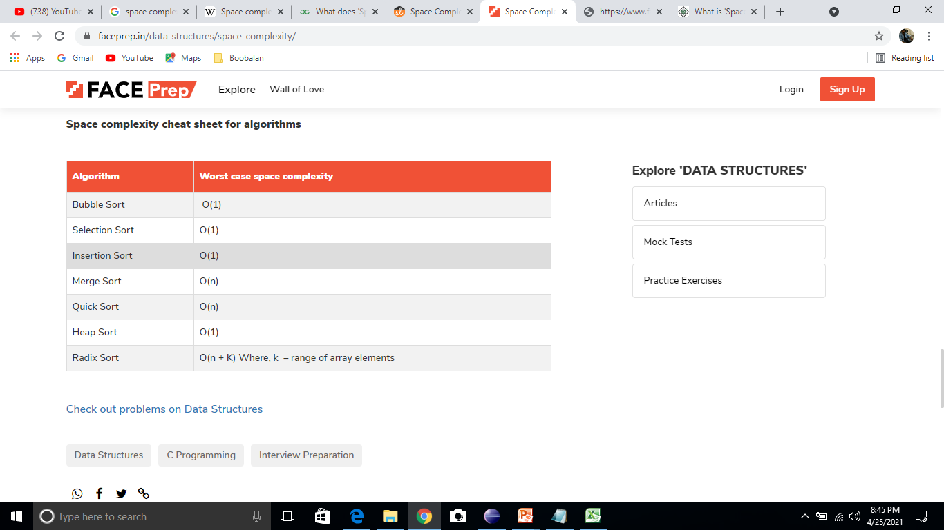
Space Complexity - Algorithms

Slide 12
An array of size n, this will require O(n) space.
Two dimensional array of size n*n, require O(n²) space.

